Slide 2
6 Calculating Z values
We need to ask what is the probability that the overall project completes in a given time.
For example with an expected time of 9.83 weeks with stdev 0.599 weeks and a second route with expected time 9.99 with stdev 0.528 what is the probability the project completes in 11 weeks?

Slide 3
Calculating Z values: example
Method:
For a target time (duration) T=11 and expected time t with standard deviation s, calculate:
non-critical path route
critical path route
Reading from the Cumulative Normal Probability (Z tables) we find:
Tasks 1 and 2 with Z=1.95 is 97.441% likely to complete before 11 weeks, and
Tasks 3 and 4 with Z=1.90 is 97.128% likely to complete before 11 weeks

Slide 4
Calculating Z values: second example
For 11 weeks we are better than 97% confident (take the lowest figure for all the routes)
What about completing the project in 10.2 weeks?
Reading from the Cumulative Normal Probability (Z tables) we find:
Tasks 1 and 2 with Z=0.6176 is approx 73% likely to complete before 10.2 weeks, and
Tasks 3 and 4 with Z=0.3977 is approx 65% likely to complete before 10.2 weeks
So, taking the lowest probability we are approx 65% confident

Slide 5
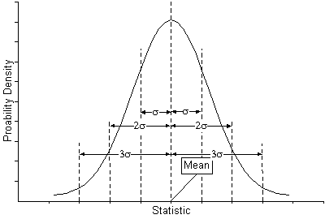
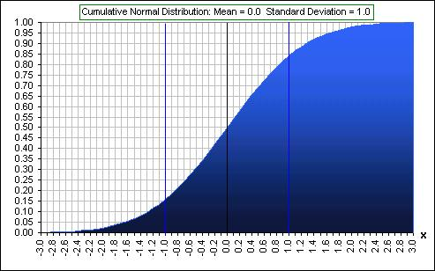
Cumulative Normal Probability Tables (Z-Values)
Z 0.00 0.01 0.02 0.03 0.04 0.05 0.06 0.07 0.08 0.09
0.0 0.50000 0.50399 0.50798 0.51197 0.51595 0.51994 0.52392 0.52790 0.53188 0.53586
0.1 0.53983 0.54380 0.54776 0.55172 0.55567 0.55962 0.56356 0.56749 0.57142 0.57535
0.2 0.57926 0.58317 0.58706 0.59095 0.59483 0.59871 0.60257 0.60642 0.61026 0.61409
0.3 0.61791 0.62172 0.62552 0.62930 0.63307 0.63683 0.64058 0.64431 0.64803 0.65173
0.4 0.65542 0.65910 0.66276 0.66640 0.67003 0.67364 0.67724 0.68082 0.68439 0.68793
0.5 0.69146 0.69497 0.69847 0.70194 0.70540 0.70884 0.71226 0.71566 0.71904 0.72240
0.6 0.72575 0.72907 0.73237 0.73565 0.73891 0.74215 0.74537 0.74857 0.75175 0.75490
0.7 0.75804 0.76115 0.76424 0.76730 0.77035 0.77337 0.77637 0.77935 0.78230 0.78524
0.8 0.78814 0.79103 0.79389 0.79673 0.79955 0.80234 0.80511 0.80785 0.81057 0.81327
0.9 0.81594 0.81859 0.82121 0.82381 0.82639 0.82894 0.83147 0.83398 0.83646 0.83891
1.0 0.84134 0.84375 0.84614 0.84849 0.85083 0.85314 0.85543 0.85769 0.85993 0.86214
1.1 0.86433 0.86650 0.86864 0.87076 0.87286 0.87493 0.87698 0.87900 0.88100 0.88298
1.2 0.88493 0.88686 0.88877 0.89065 0.89251 0.89435 0.89617 0.89796 0.89973 0.90147
1.3 0.90320 0.90490 0.90658 0.90824 0.90988 0.91149 0.91308 0.91466 0.91621 0.91774
1.4 0.91924 0.92073 0.92220 0.92364 0.92507 0.92647 0.92785 0.92922 0.93056 0.93189
1.5 0.93319 0.93448 0.93574 0.93699 0.93822 0.93943 0.94062 0.94179 0.94295 0.94408
1.6 0.94520 0.94630 0.94738 0.94845 0.94950 0.95053 0.95154 0.95254 0.95352 0.95449
1.7 0.95543 0.95637 0.95728 0.95818 0.95907 0.95994 0.96080 0.96164 0.96246 0.96327
1.8 0.96407 0.96485 0.96562 0.96638 0.96712 0.96784 0.96856 0.96926 0.96995 0.97062
1.9 0.97128 0.97193 0.97257 0.97320 0.97381 0.97441 0.97500 0.97558 0.97615 0.97670
2.0 0.97725 0.97778 0.97831 0.97882 0.97932 0.97982 0.98030 0.98077 0.98124 0.98169
2.1 0.98214 0.98257 0.98300 0.98341 0.98382 0.98422 0.98461 0.98500 0.98537 0.98574
2.2 0.98610 0.98645 0.98679 0.98713 0.98745 0.98778 0.98809 0.98840 0.98870 0.98899
2.3 0.98928 0.98956 0.98983 0.99010 0.99036 0.99061 0.99086 0.99111 0.99134 0.99158
2.4 0.99180 0.99202 0.99224 0.99245 0.99266 0.99286 0.99305 0.99324 0.99343 0.99361
2.5 0.99379 0.99396 0.99413 0.99430 0.99446 0.99461 0.99477 0.99492 0.99506 0.99520
2.6 0.99534 0.99547 0.99560 0.99573 0.99585 0.99598 0.99609 0.99621 0.99632 0.99643
2.7 0.99653 0.99664 0.99674 0.99683 0.99693 0.99702 0.99711 0.99720 0.99728 0.99736
2.8 0.99744 0.99752 0.99760 0.99767 0.99774 0.99781 0.99788 0.99795 0.99801 0.99807
2.9 0.99813 0.99819 0.99825 0.99831 0.99836 0.99841 0.99846 0.99851 0.99856 0.99861
3.0 0.99865 0.99869 0.99874 0.99878 0.99882 0.99886 0.99889 0.99893 0.99896 0.99900
3.1 0.99903 0.99906 0.99910 0.99913 0.99916 0.99918 0.99921 0.99924 0.99926 0.99929
3.2 0.99931 0.99934 0.99936 0.99938 0.99940 0.99942 0.99944 0.99946 0.99948 0.99950
3.3 0.99952 0.99953 0.99955 0.99957 0.99958 0.99960 0.99961 0.99962 0.99964 0.99965
3.4 0.99966 0.99968 0.99969 0.99970 0.99971 0.99972 0.99973 0.99974 0.99975 0.99976
3.5 0.99977 0.99978 0.99978 0.99979 0.99980 0.99981 0.99981 0.99982 0.99983 0.99983
3.6 0.99984 0.99985 0.99985 0.99986 0.99986 0.99987 0.99987 0.99988 0.99988 0.99989
3.7 0.99989 0.99990 0.99990 0.99990 0.99991 0.99991 0.99992 0.99992 0.99992 0.99992
3.8 0.99993 0.99993 0.99993 0.99994 0.99994 0.99994 0.99994 0.99995 0.99995 0.99995
3.9 0.99995 0.99995 0.99996 0.99996 0.99996 0.99996 0.99996 0.99996 0.99997 0.99997
4.0 0.99997 0.99997 0.99997 0.99997 0.99997 0.99997 0.99998 0.99998 0.99998 0.99998
Notes:
Note Z(-x)=1-Z(x)

